Slide 2

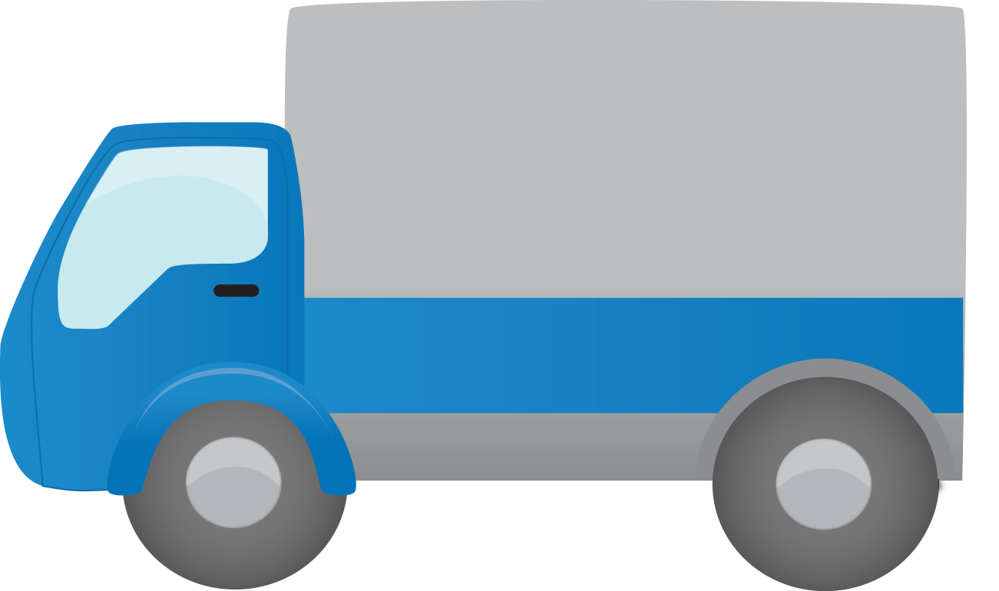

DISPATCHER
TRUCK DRIVERS
SHIPMENT ORDERS

Slide 3
1
3
2
K-MEANS
ALGORITHM
DISPATCHER
TRUCK DRIVERS
SHIPMENT ORDERS

Slide 4
K-Means Algorithm takes two variables as the inputs:
1
The observations that we want to cluster
2
The size of the cluster that we want to create

